Slide 1
Operating Systems
Course Introduction
Dr. 何明昕 HE Mingxin, MX, Max
Send your email to c.max@yeah.net with
a subject like: OS-id-Andy: On What …
Download from c.program@yeah.net
/文件中心/网盘/OperatingSystems26S
Book site: https://codex.cs.yale.edu/avi/os-book/OS10/index.html

Slide 2
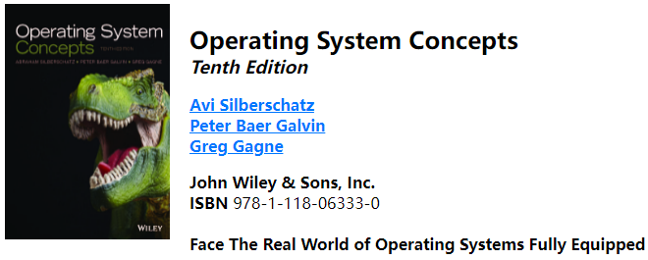
Course References
Lecture slides are your primary reference
Other references to be provided as we proceed
Recommended textbook:
https://codex.cs.yale.edu/avi/os-book/OS10/index.html

Slide 3
Syllabus at a Glance (ch1~ch15, ch18?)
Chapter 1: Introduction
Chapter 2: Operating System Structures
Chapter 3: Processes
Chapter 4: Threads & Concurrency
Chapter 5: CPU Scheduling
Chapter 6: Synchronization Tools
Chapter 7 Synchronization Examples
Chapter 8: Deadlocks
Chapter 9: Main Memory
Chapter 10: Virtual Memory
Chapter 11: Mass-Storage Structure
Chapter 12: I/O Systems
Chapter 13: File-System Interface
Chapter 14: File-System Implementation
Chapter 15: File-System Internals
Chapter 18: Virtual Machines (optional)

Slide 4
Course Lectures & Labs
操作系统 3.5学分
1-17周: 周一 6-8节【14:00-16:35】番禺校区教学大楼222教室
1-2 周: 周三 3-4节【10:30-12:10】番禺校区教学大楼330教室
操作系统实验 0.5学分
3, 5 周: 周三3-4节【10:30-12:10】番禺校区教学大楼126机房
4, 6, 8, 10, 12, 14, 16周:
周三3-4节【10:30-12:10】 番禺校区教学大楼116机房

Slide 5
Grading
Operating Systems (3.5 credits)
Class Participation: 10%
2+ Assignments: 10%
Labs: 20%
Final Exam: 60% (Closed-book, from Lectures, References & Labs)
Labs on Operating Systems (0.5 credits)
Lab Participation: 30%
6+ Lab submits: 20%
Qualities of the 6+ Labs: 50%

Slide 6
What to expect
The course would be quite involved
Lot of concepts
Some programming
Reasonable workload
Let me know if you have any question
I guarantee that
Encourage you to do your best
You’ll have fun
Help you learn as much as I can – don’t hesitate to ask for help whenever needed
Although you won’t become experts, you will learn enough to move on!

Slide 7
What I expect you to
Attend each Lecture and each Lab
Preview & Review lecture slides & reference before/after each lecture
Ask questions during lectures
Ask questions by the Course Group on WeChat
Ask questions over email : c.max @ yeah.net
Try to start early on assignments
Don’t wait until the very last minute
Follow the instructions and submit assignments on time

Slide 8
Attendance Policy
Attendance will be taken randomly
If you fail to attend the lectures at 3 times without prior notification of your absence, your attendance grade will be 0.

Slide 9
Late Homework Policy
None – no late homework is allowed
Either you submit on time and your homework will be graded OR you submit late, and the homework is NOT graded
You should stick to deadlines
Exception will be made ONLY under genuine circumstances (LATER IS BETTER THAN NEVER :-)

Slide 10
Three Dimensions of most CST Courses
Most of Courses on CST is organized by a combination of elements from the following 3 dimensions:
THEORY related: Maths, Concepts, Models, Algorithms, Principles, Mechanisms, Methods, … Need to understand Abstract Things
SYSTEM and TOOLS related: HW, Network, OS, PLs, IDEs, DBMS, Clients, Servers, Virtual Machines, Containers in Cloud, … Need to understand, set and use them properly
DESIGN related: According to Requirements (Problems), need to use Theory and Tools to shape/implement/test Solutions!
Put them all together!!!

Slide 11
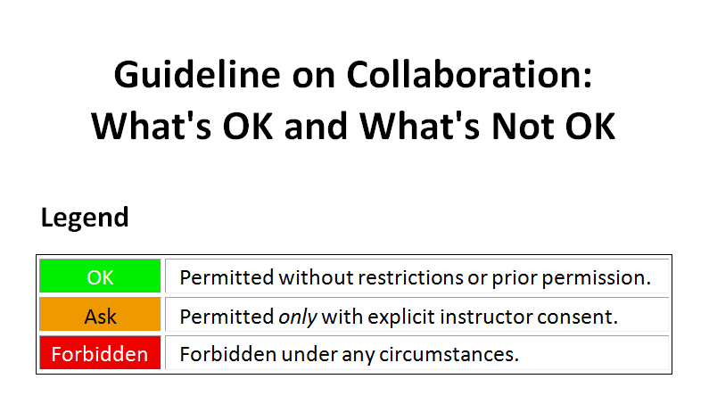

Slide 12
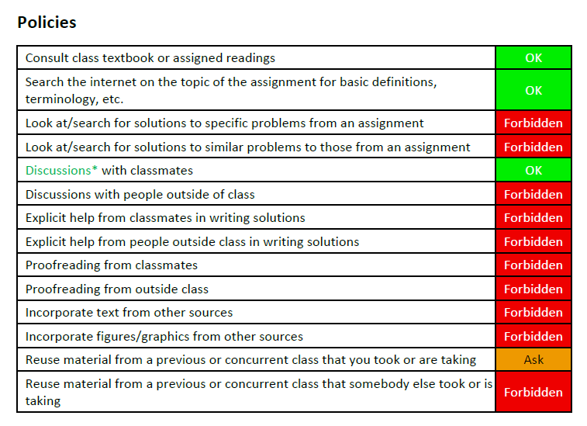
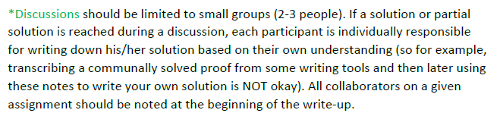

Slide 13
End of Course Introduction

